Slide 1

Smart logistics
Lesson 7 - Sensors and smart supply chains
Minor SCE

Slide 2
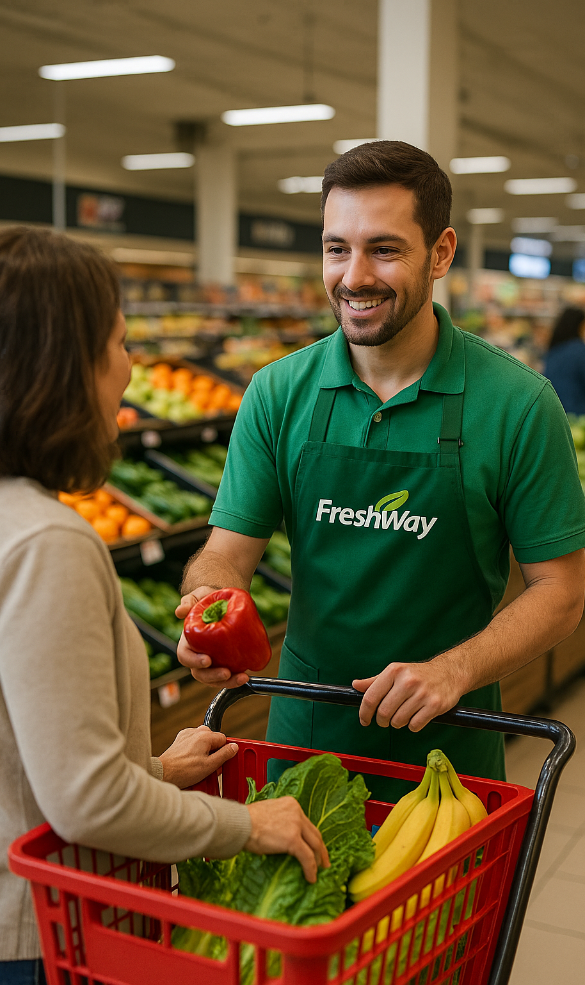
Course Overview
Smart logistics
1 Introduction and company start-up
2 Smart logistics and business intelligence
3 Data driven logistics
4 Digital developments
5 AI and GenAI in logistics
6 Self organising logistics
7 Sensors and smart supply chains
8 Assessment
9 End presentation
Notes:
Standardised nine-topic list, canonical English wording from the lesson-concept document (Sept 2026).
If the nine-lesson concept is not adopted, delete this slide and keep the old one.
Note: this deck was the only one showing a different list ('Collaboration and integration' + 'Presentation') because the hub lesson was dropped during delivery in 2025.

Slide 3
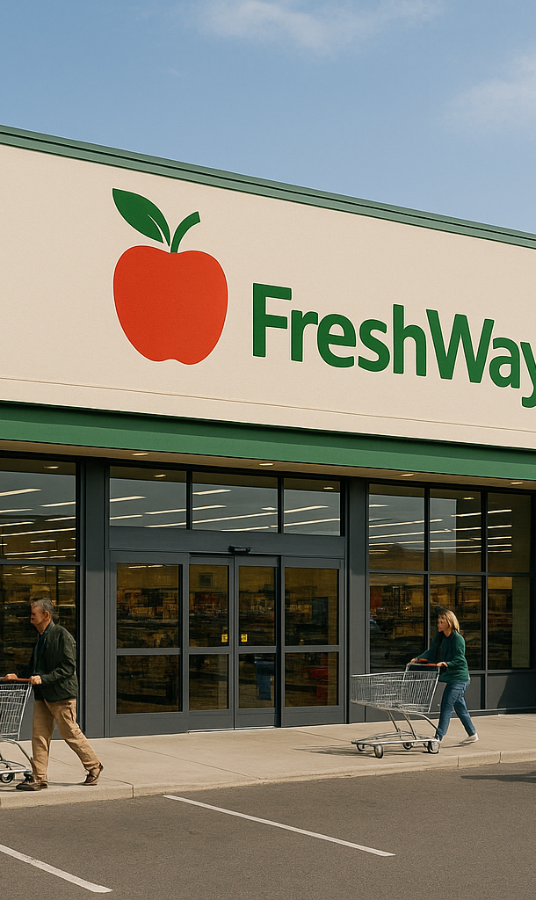
Smart warehousing & transport
Smart Logistics
New technologies and innovations:
New technologies offer the opportunity to make our logistics smarter
That not only leads to lower costs, but also to faster and more flexible processes
Smart logistics is about the smart organization of our logistics processes

Slide 4
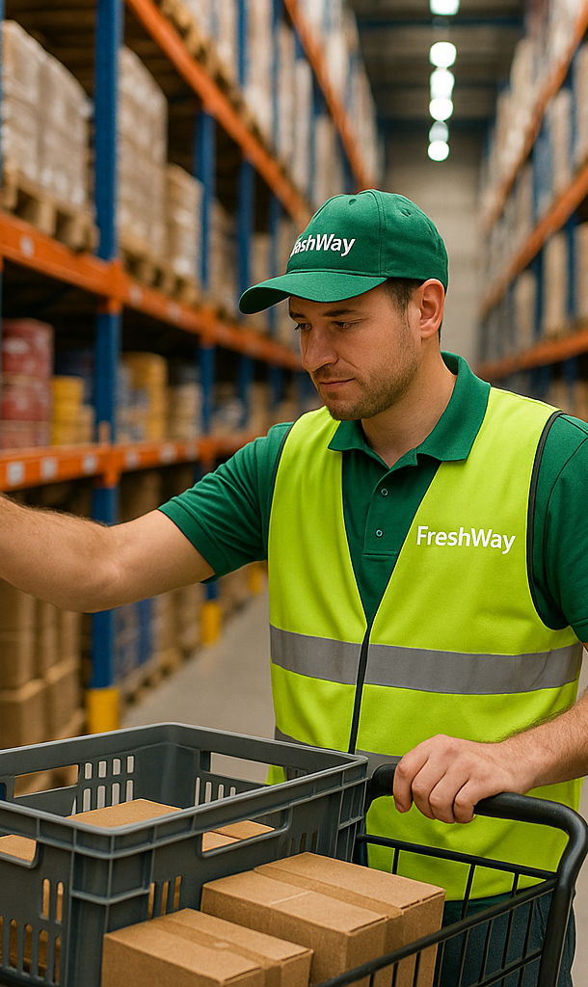
Presentation time
Impact map: Group 2, 4

Slide 5
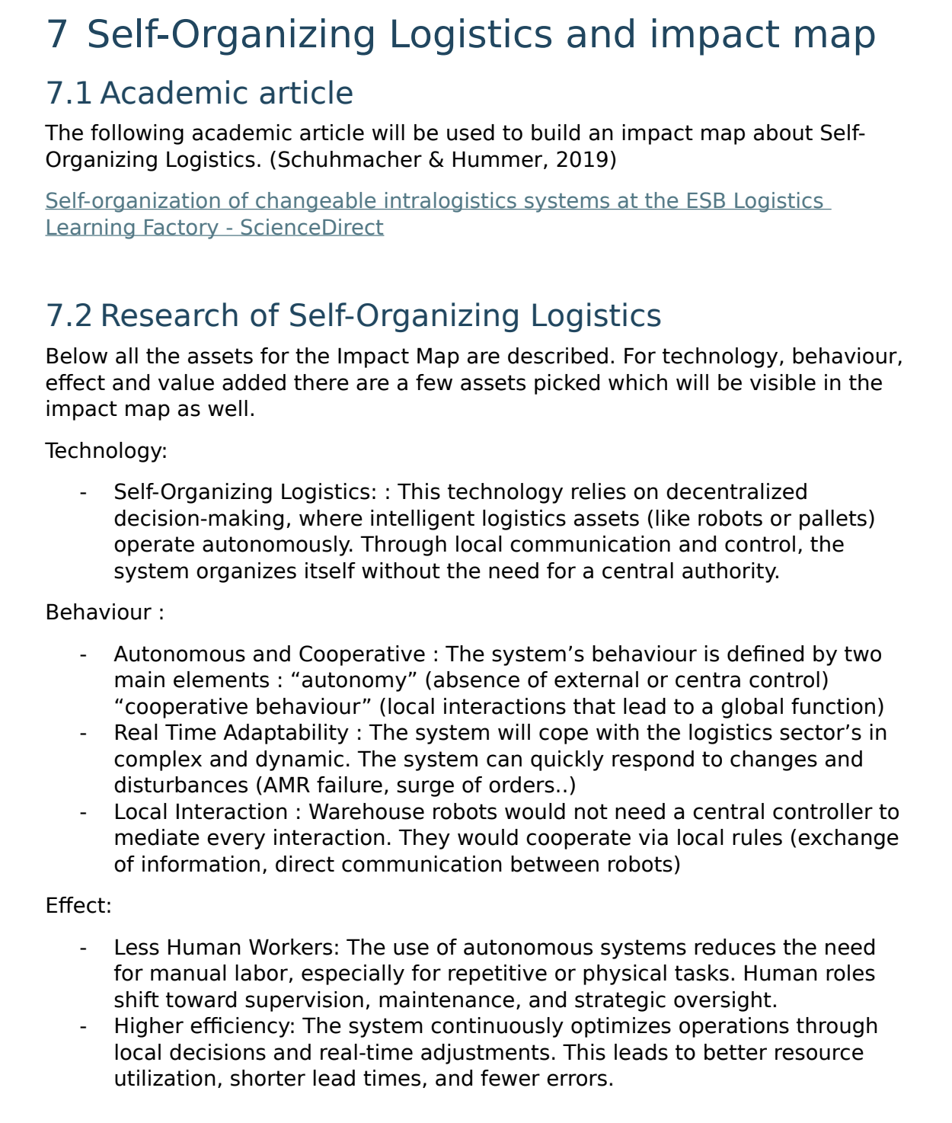
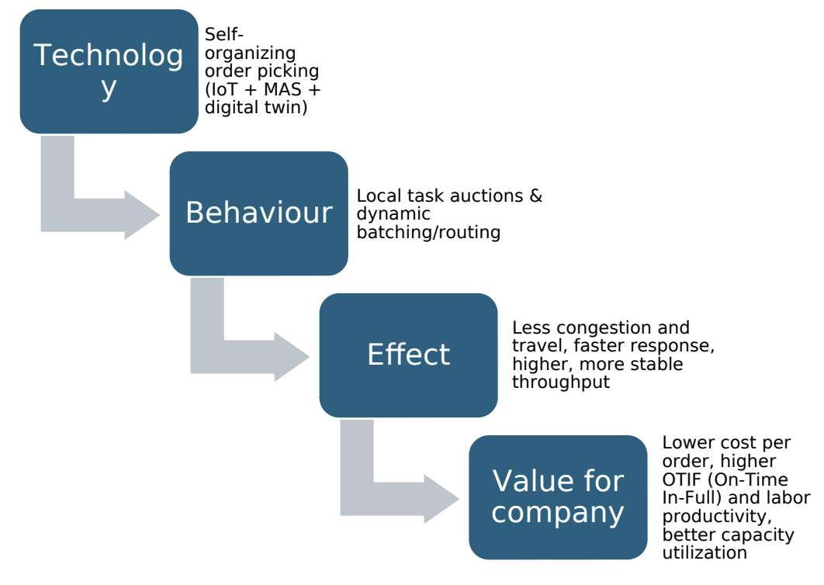
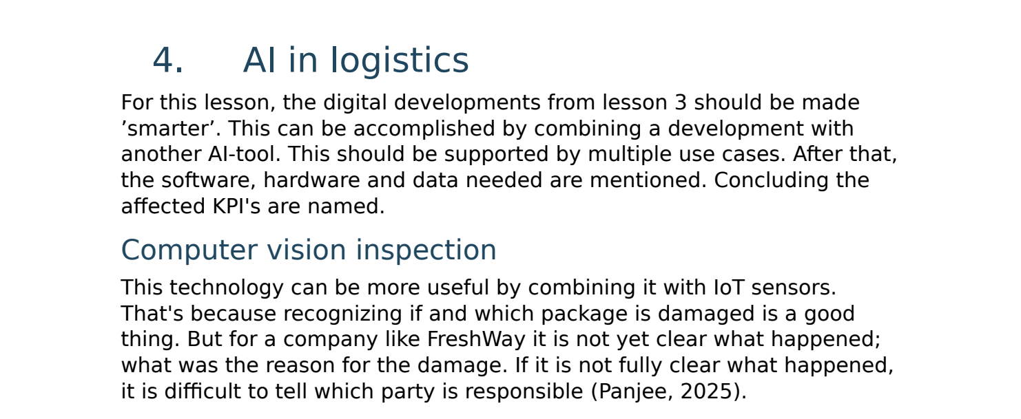
Feedback
Smart Logistics

Slide 6
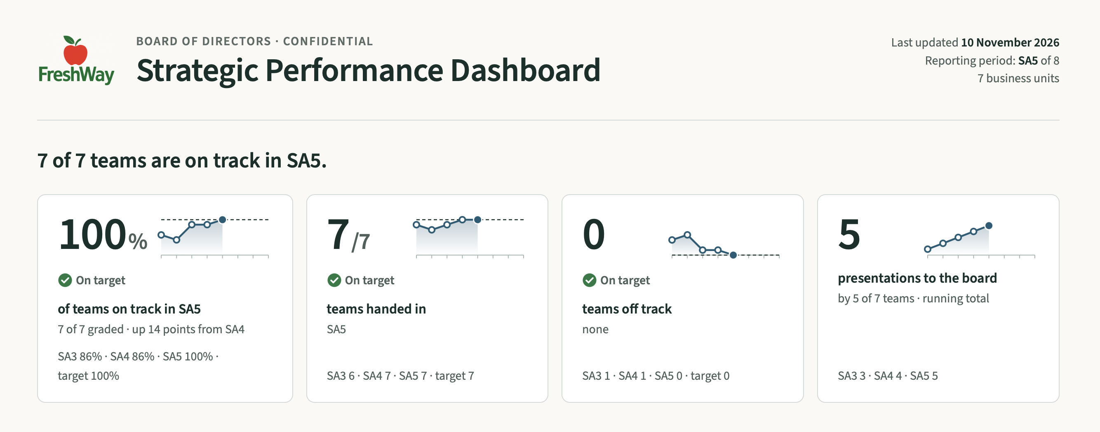

Slide 7
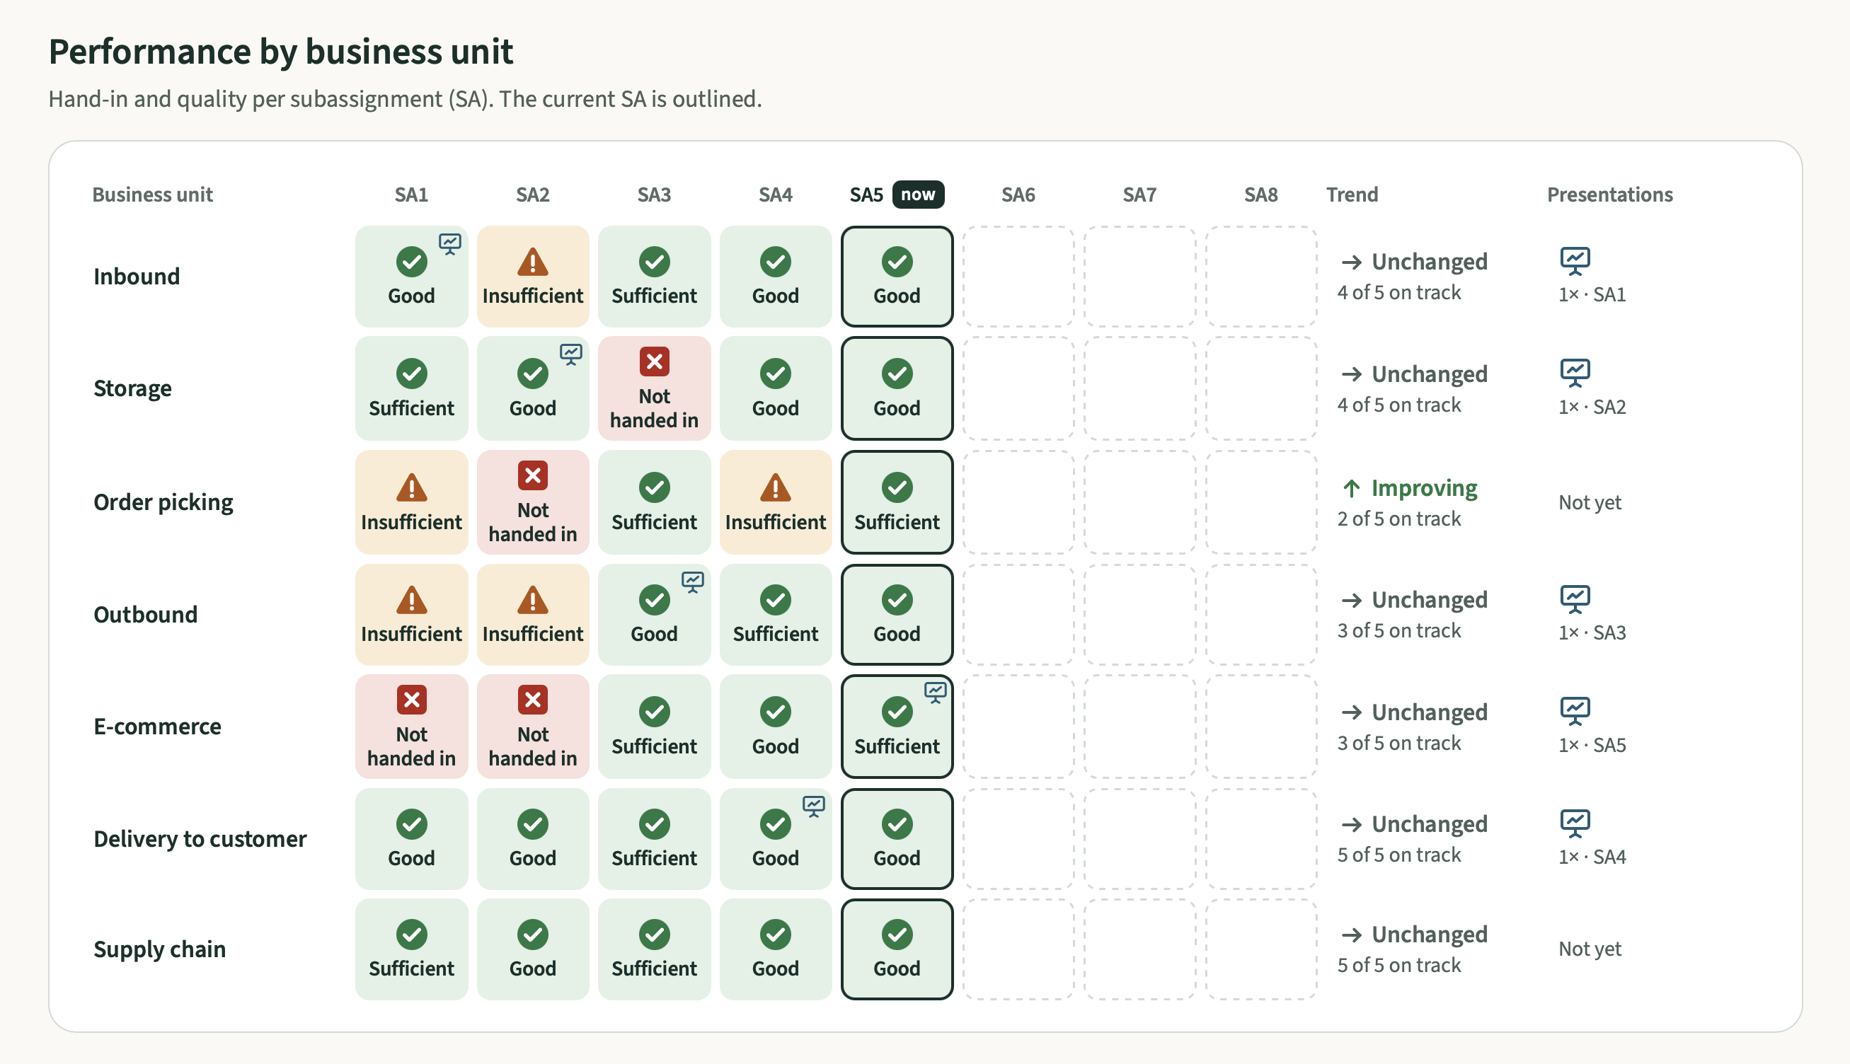

Slide 8
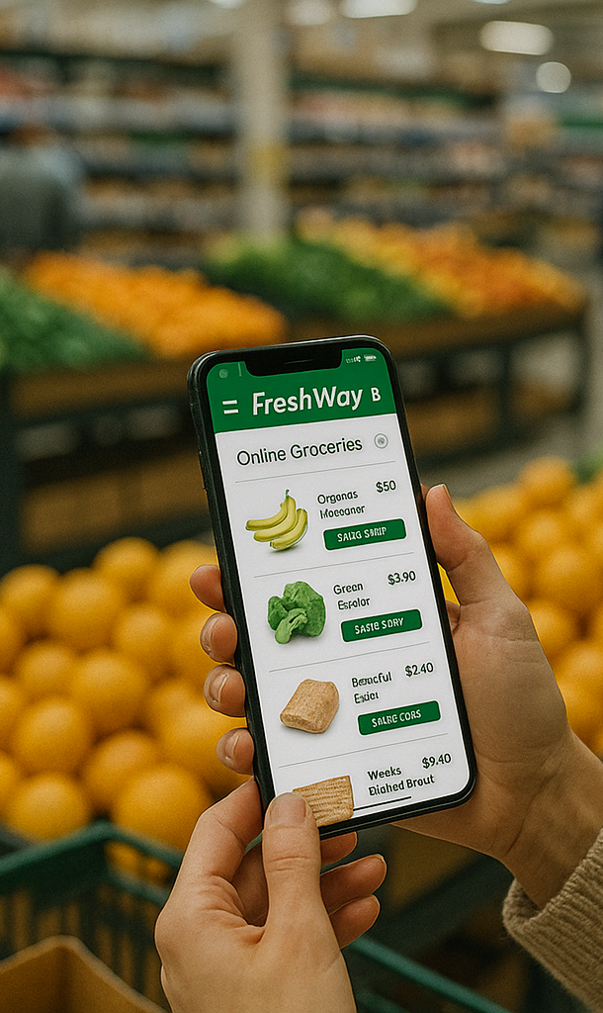
Recap until now
Logistics is getting smarter using technology and data
To leverage these possibilities, we need a sturdy IT architecture, systems and software
Based on this backbone we can add new digital solutions
Cloud based solutions, interoperability and federated learning are key developments
AI makes operations even smarter
Which enables self organizing logistics

Slide 9
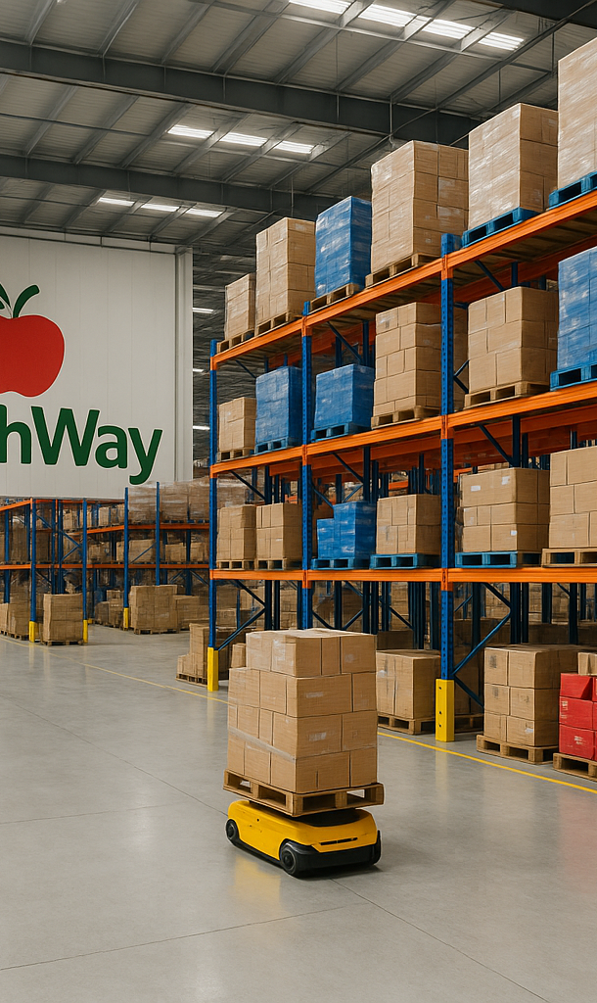
Topics of today
Smart Logistics
Sensor- and IoT applications
Realtime track & trace
Bio- and nanosensors
Smart access policies
Smart supply chains

Slide 10
Sensor- and IOT applications

Slide 11
Sensors & IoT: Connecting the Physical and Digital World
In the previous lesson, we learned how self-organising logistics systems can make decisions and adapt to changing conditions.
But how do these systems know what is happening in the real world?
Today:
  Sensors collect real-time data, such as location, temperature, movement and vibration.
  IoT (Internet of Things) connects devices and allows them to exchange data with other systems.
This data enables smart logistics systems to monitor processes, detect changes and respond automatically.
Today, we will explore how this works and how FreshWay can use these technologies.
Notes:
In the previous lesson, we discussed self-organising logistics: systems that can make decisions and adapt to changing conditions.
For example, warehouse robots can automatically redistribute tasks when one robot breaks down.
But how does the system know that a robot has stopped working? And how does it know where the other robots are?
This is where sensors and the Internet of Things (IoT) come in.
Sensors collect information from the physical world, such as temperature, location, movement or vibration.
IoT technology allows devices to communicate and exchange this information with other systems.
Software can then analyse the data and decide whether action is needed.
In short: sensors provide the information that smart logistics systems need to respond to real-world conditions.
Today, we will explore how this works and how FreshWay can use these technologies.

Slide 12
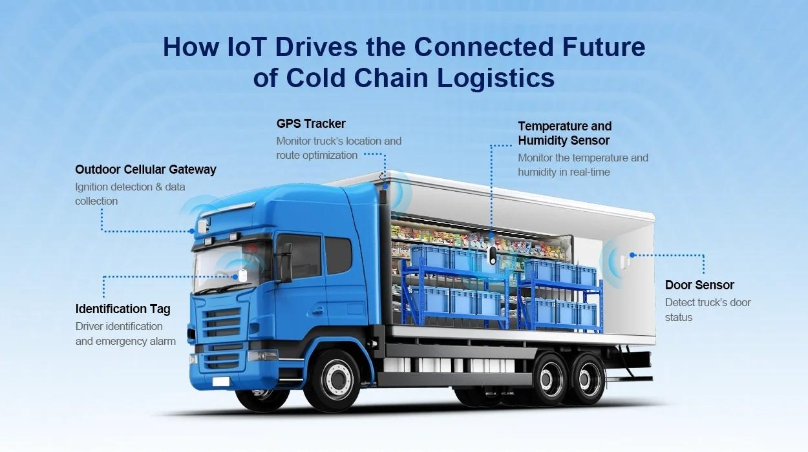
Realtime visibility
Sensors and IoT provide real-time information about the location and condition of goods, vehicles and equipment.
  Location of trucks & goods
  Condition of goods
  End-to-end tracking of shipments
Improved transparency
Companies can detect delays or problems earlier and take corrective action.
This improves reliability, reduces losses and supports better logistics decisions.

Slide 13
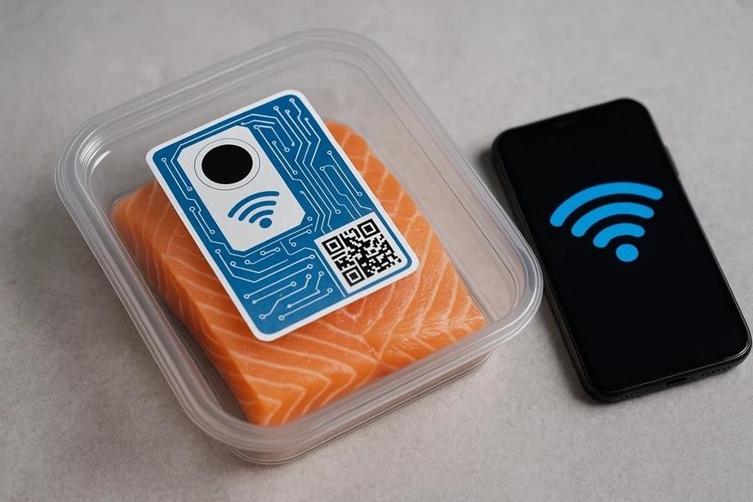
Biosensors – Monitoring Food Quality and Safety
Traditional sensors measure physical conditions, such as temperature, humidity and location.
Biosensors use biological recognition elements to detect specific substances, such as bacteria or toxins.
They can help identify food contamination, for example during production or incoming goods inspection.
This allows companies to detect quality problems earlier and improve food safety.
Biosensors are promising, but many applications are still being developed.
Notes:
So far, we have discussed sensors that measure temperature, location and movement. But there are also more advanced sensors that can help us monitor food safety.
Biosensors use biological components to identify specific substances. For example, they can be designed to detect harmful bacteria such as Salmonella or E. coli.
Imagine FreshWay receiving a shipment of fresh food. Instead of relying only on temperature measurements, a biosensor-based test could help detect contamination during incoming goods inspection.
However, this technology is still developing. Many applications are not yet sufficiently validated for widespread use in everyday logistics operations.

Slide 14
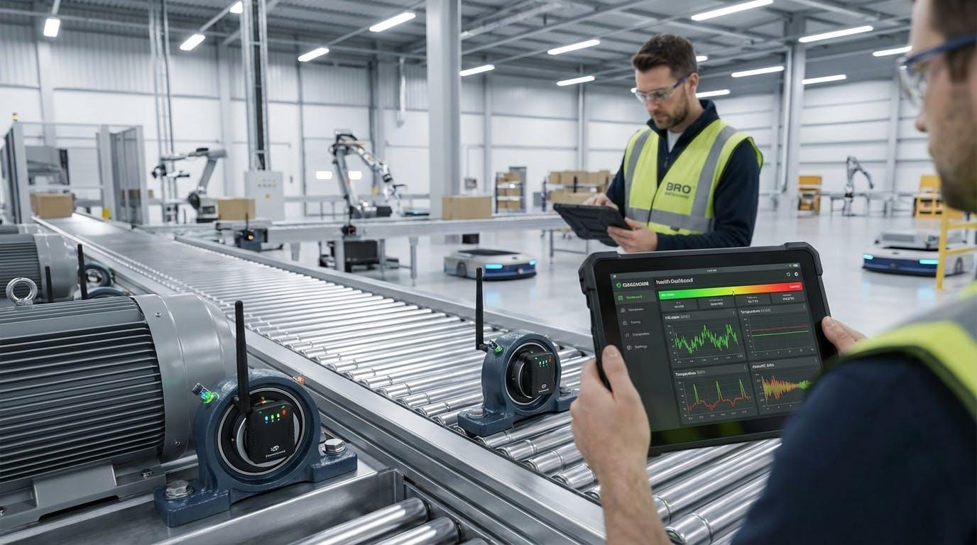
RFID & Predictive Maintenance
RFID – Tracking Goods
RFID tags allow products, pallets and containers to be identified automatically.
RFID readers register when goods pass specific points in a warehouse or supply chain.
This improves inventory accuracy, traceability and warehouse efficiency.
Predictive Maintenance – Monitoring Equipment with sensors
Reactive maintenance | Repair after a failure
Preventive maintenance | Maintain at fixed intervals
Condition-based maintenance | Maintain when measurements indicate deterioration
Predictive maintenance | Use data and models to estimate future failures or maintenance needs
Notes:
Besides tracking shipments and monitoring food quality, sensors and IoT also have important applications inside warehouses.
RFID stands for Radio Frequency Identification. RFID tags can be attached to products, pallets or containers and identified wirelessly by RFID readers.
For example, when a pallet enters a FreshWay distribution centre, an RFID reader can automatically register its arrival. This helps maintain accurate inventory records and reduces manual scanning.
Predictive maintenance is another application. Sensors continuously or periodically monitor equipment such as conveyor belts, shuttles and warehouse robots.
By analysing changes in vibration, temperature or machine performance, companies can identify potential problems before equipment breaks down.
For FreshWay, this could help prevent disruptions in its automated Central Distribution Centre, where shuttles and mechanised palletising systems are used.

Slide 15
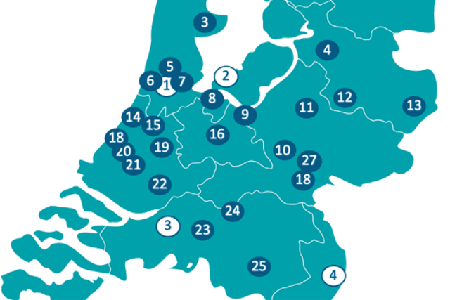
Smart Access Policies
Cities are increasingly regulating access for delivery vehicles to reduce emissions, congestion and nuisance.
Access may depend on vehicle type, emission standards, delivery times or permits.
Digital technologies, such as GPS, geofencing and automatic number plate recognition, can help monitor and manage access.
Logistics systems can use this information to plan routes and prevent vehicles from entering restricted areas.
Geofencing is a location-based technology that creates a virtual (digital) boundary around a real-world geographic area
Notes:
Smart access policies are about controlling which vehicles can enter certain areas and under what conditions.
For example, many Dutch cities have introduced zero-emission zones for freight transport. Depending on the regulations and applicable exemptions, certain vehicles are not allowed to enter these zones.
Technology can help logistics companies comply with these rules.
Geofencing creates a virtual boundary around a geographical area using location technology. When a vehicle approaches or crosses this boundary, the system can trigger a warning or another predefined action.
Automatic number plate recognition can also be used by authorities to check whether vehicles are permitted to enter restricted areas.
For FreshWay, this could mean that its transport planning system automatically checks whether a delivery vehicle is allowed to enter a city centre and suggests an alternative vehicle or route if necessary.

Slide 16
Smart Access Policies → Applications
Data Integration:
  vehicle information, such as vehicle type, emissions and permits, is shared with digital access systems.
Geofencing:
  virtual boundaries are created around restricted areas, such as zero-emission zones.
  GPS technology detects when a vehicle approaches or enters these areas.
Automated Verification
  Digital systems check whether a vehicle is allowed to enter a restricted area.
  Cameras or access systems can automatically verify or control entry.
Digital Permitting
  Digital permits replace paper permits and can be checked automatically.
Notes:
Smart access policies combine several digital technologies.
First, vehicle information and access regulations must be available in digital systems.
Geofencing uses GPS and digital maps to define virtual boundaries. A vehicle entering such an area can trigger a warning in the navigation or transport management system.
Automated verification is another application. For example, cameras can recognise number plates and check whether a vehicle has permission to enter a restricted zone.
Finally, digital permits make it easier to manage exemptions and access rights without paperwork.
For FreshWay, these technologies could help ensure that the right delivery vehicles are assigned to the right destinations.

Slide 17
From Sensor Data to Smart Decisions
Sensors collect raw data about physical logistics processes, such as temperature, location and equipment performance.
IoT networks transmit this data to digital platforms, where it can be stored, combined and analysed.
Edge computing processes data close to the sensor, enabling faster responses without always relying on cloud connectivity.
AI and analytics can identify patterns, predict problems and recommend or automate decisions.
Integration with systems such as WMS, TMS and ERP enables these decisions to influence real logistics operations.
The result: logistics systems that can monitor, predict and respond to changing conditions.

Slide 18
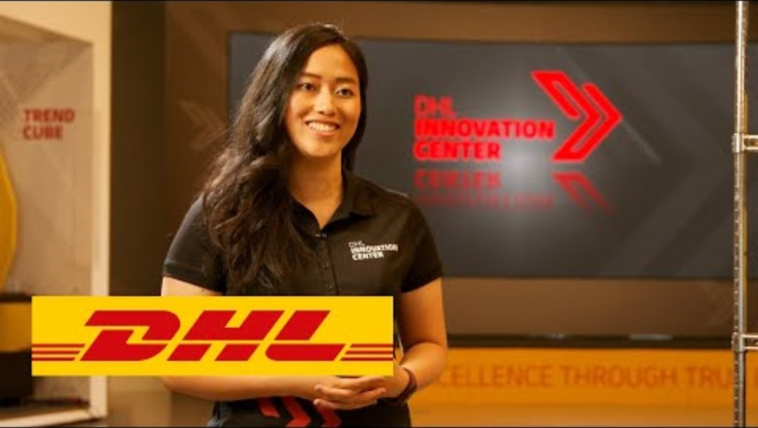

Slide 19
Assignment
Work in your groups
Identify logistics processes within your department that could benefit from sensors or IoT.
Discuss which sensors could be useful and what data they would collect.
Explain how this data could improve logistics operations or support better decisions.
Select the two most promising applications for your department.
Present your ideas to the class on one slide.

Slide 20
Smart Supply chains

Slide 21
From Smart Logistics to Smart Supply Chains
Smart logistics focuses on improving individual logistics processes using technology and data.
A smart supply chain connects these processes across different companies and locations.
By sharing real-time information, suppliers, warehouses, transport companies and customers can coordinate their activities.
This allows the supply chain to respond faster to disruptions, changing demand and delivery problems.
The result is better collaboration, greater flexibility and improved overall supply chain performance.
Notes:
Until now, we have mainly looked at how technology can improve individual logistics operations.
But a supply chain consists of multiple organisations and departments that depend on each other.
Imagine that FreshWay receives information from a supplier that a delivery will be delayed.
If this information is shared automatically, the central distribution centre can adjust its planning. Regional distribution centres and transport planners can then prepare for the consequences.
The important point is that each department should not optimise its own processes in isolation.
A smart supply chain uses shared information to coordinate decisions across the entire chain.
This is especially relevant for your FreshWay project, where all departments must develop one integrated logistics solution.

Slide 22
Blockchain in Smart Supply Chains
Blockchain is a technology for recording and sharing information in a distributed digital ledger.
Supply chain partners can use it to share traceability information in a transparent and tamper-resistant way.
Walmart has used blockchain technology to improve food traceability.
TradeLens (Maersk & IBM) was discontinued in 2023 because it failed to achieve sufficient industry-wide participation.
The main challenge is not only technology, but also collaboration, trust and data sharing between supply chain partners.
Notes:
A blockchain is a shared digital ledger in which transactions or events are recorded. Multiple organisations can access the information, and changes to existing records are difficult to make without detection.
In logistics, blockchain can help companies trace products through the supply chain.
For example, Walmart has used blockchain to trace food products back to their origin. This can help identify affected products more quickly when a food safety problem occurs.
However, blockchain is not always successful.
Maersk and IBM developed TradeLens to share shipping information between companies. Although the technology worked, the platform did not attract enough industry-wide participation to become commercially viable. It was discontinued in 2023.
This illustrates an important lesson: smart supply chains require more than smart technology. Companies also need common standards, trust and a willingness to share information.
For FreshWay, the question is not whether every department needs blockchain, but how information can be shared reliably across the supply chain.

Slide 23
Next sub-assignment
Portfolio
Research feasible sensor applications within your department
Fill out the sensor application canvas for one application

Slide 25
Portfolio Assignment – Sensor Application Canvas
Select the most promising sensor or IoT application for your FreshWay department.
Explain which logistics problem the application addresses.
Describe what data is collected and how this information is used.
Explain how the application improves logistics operations or supports decision-making.
Consider how the application connects with other FreshWay departments.
Complete the Sensor Application Canvas for your chosen application.

Slide 26
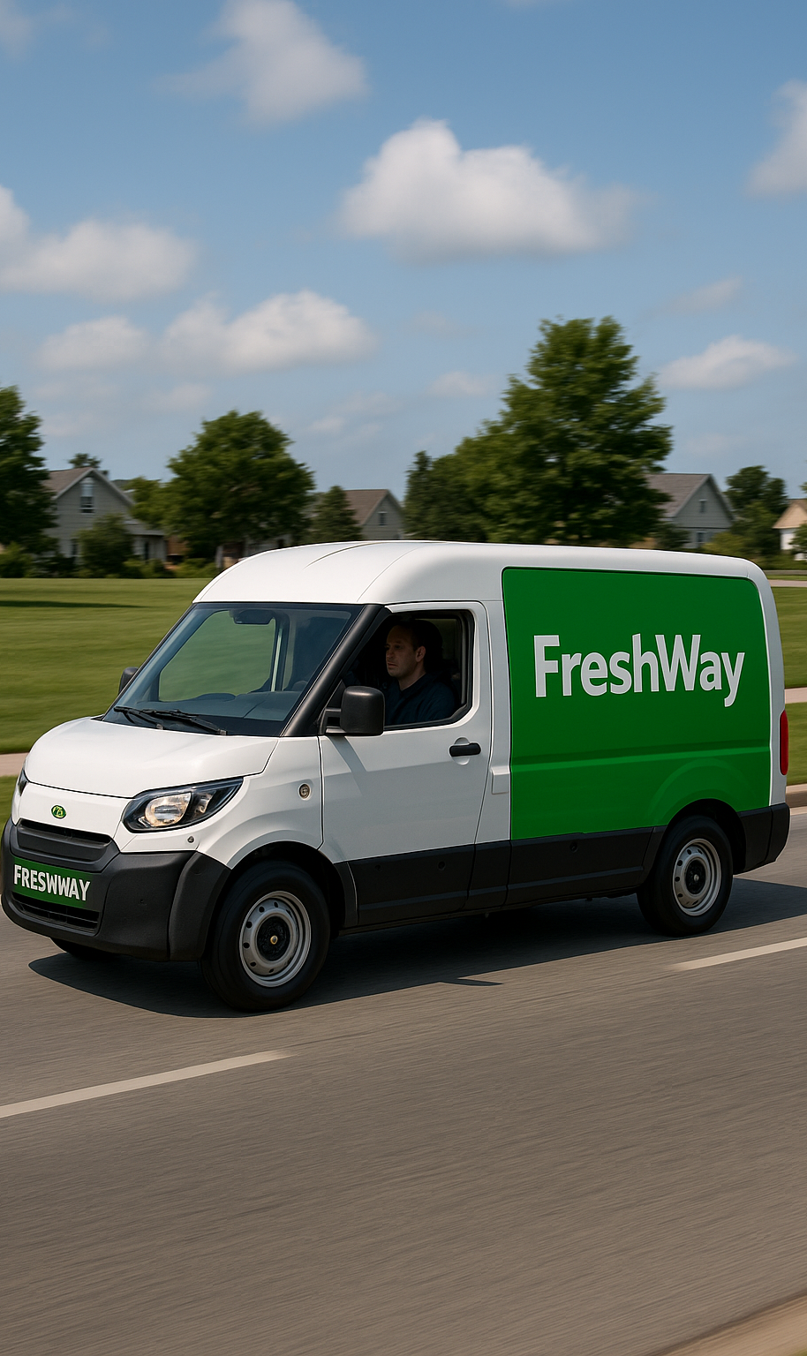
Final assessment (18 nov)
Each group individually
20 min for each group
5-7 min presentation
13-15 min questions for each group member
We will give feedback
Each group member must know your entire solution
”I didn’t do that part” is not ok

Slide 27
Peer assessment – Own performance
 | Name student:
 | Evaluation of Own Performance | Score
Attitude and Behavior | I am present and arrive on time.
 | I encourage collaboration.
 | I listen to others and handle differing viewpoints and opinions appropriately.
 | I seek feedback and handle it effectively.
 | I reflect on my own performance and adjust when necessary.
Contribution to the Project | I actively contribute during task pre-discussions.
 | I complete tasks according to group norms.
 | I bring ideas, thoughts, and assumptions to the table.
 | I contribute to acquiring, applying, and processing information.
 | Final score (whole numbers)
 | *The student assigns themselves a score of 80%, 90%, 100%, 110%, or 120% per criterion.

Slide 28
Peer assessment – Group assessment
 | Names
Final evaluation* | Student A | Student B | Student C | Student D | Student E
gives a score of to | 100% | 90% | 90% | 100% | 120% | 500%
gives a score of to | 100% | 90% | 80% | 110% | 120% | 500%
gives a score of to | 100% | 90% | 80% | 120% | 110% | 500%
gives a score of to | 100% | 90% | 100% | 100% | 110% | 500%
gives a score of to | 100% | 90% | 90% | 100% | 120% | 500%
Final score** | 100% | 90% | 88% | 106% | 116%
*student scores the other group members, based on a dialogue at 80%, 90%, 100%, 110% of 120% contribution to the project.
** the percentage is an advice to the teachers

Slide 29

Final presentation (25 nov)
Present your integral solution for FreshWay
Make clear what technologies will help FreshWay to be future proof
Make it an integral story with
  One layout
  Connections between departments
  Make it visually appealing
  Tip: Use a customer journey as central narrative

Slide 30
GenAI transparency
GenAI
These slides build on the 2025 course materials written by your lecturers. For 2026 the facts, figures and examples were checked and updated with GenAI support, and a number of slides were added.
Human-AI Agency Label: Creative Director — your lecturers set the structure and the line of reasoning; GenAI carried out specific parts within that frame, and every change was checked before it went in.
Labels source: Boetje, J., & Baake, G. (2026). Nine prototypical human-AI agency patterns [Figure]. figshare. https://doi.org/10.6084/m9.figshare.31706884 (CC BY 4.0).
Notes:
Afsluitende dia: de GenAI-verklaring bij dit deck. Kort benoemen dat wij als docenten zelf ook transparant zijn over GenAI-gebruik — hetzelfde als wat wij van jullie vragen bij het portfolio. Niet voorlezen; één zin volstaat.

